Slide 1
ITCS-6100
Final Project
Group 1
Joseph Mauney, Hunter Sandlin, Cody Spencer, Allyson Vasquez, Jay Yadav

Slide 2
Project Blue Sky
Background:
ELO Inc. recently developed a revolutionary technology that can supply all of the world’s power needs with a renewable source of energy by harnessing the sun. This technology can be transmitted without wires allowing for remote installation and zero transportation costs
Business Objective:
Group 1 has been hired to identify the optimal location to install their fleet of solar panels. Costs have been subcontracted out to a firm that has given a flat fee for install regardless of install location. The only factor in CAPEX cost is centered around number of panels
KPI:
Project Blue Sky will be evaluated on how much sunlight the proposed area is expected to receive, relative to all other choices. Increased sunlight means more power generation from the panels and less upfront CAPEX cost

Slide 3
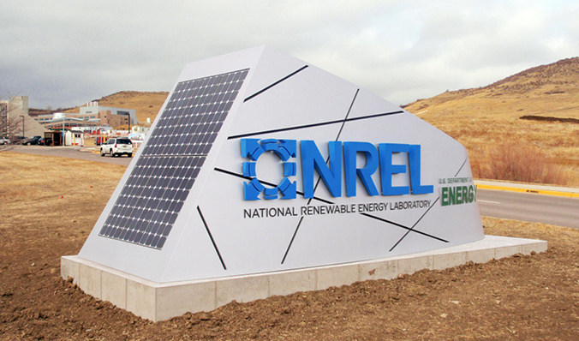
About the Data
We used a section of data provided by the National Renewable Energy Laboratory.
They utilized a lidar-based scanning method to create a database of potential solar panel planes on rooftops for over 128 metropolitan regions in the US

Slide 4
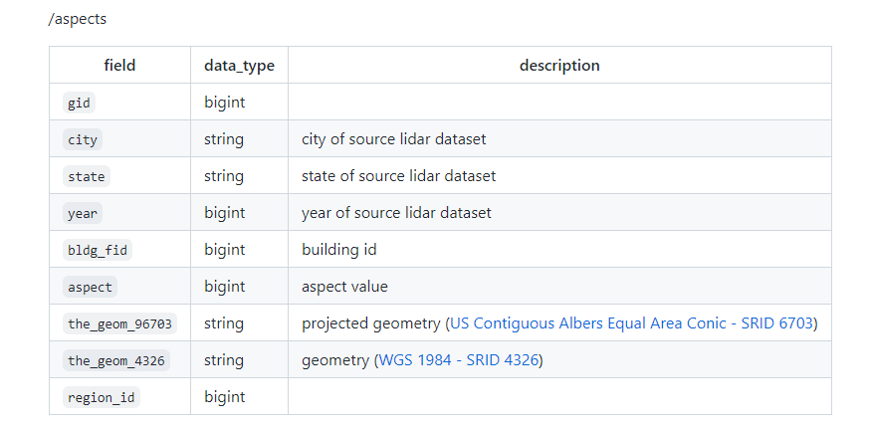
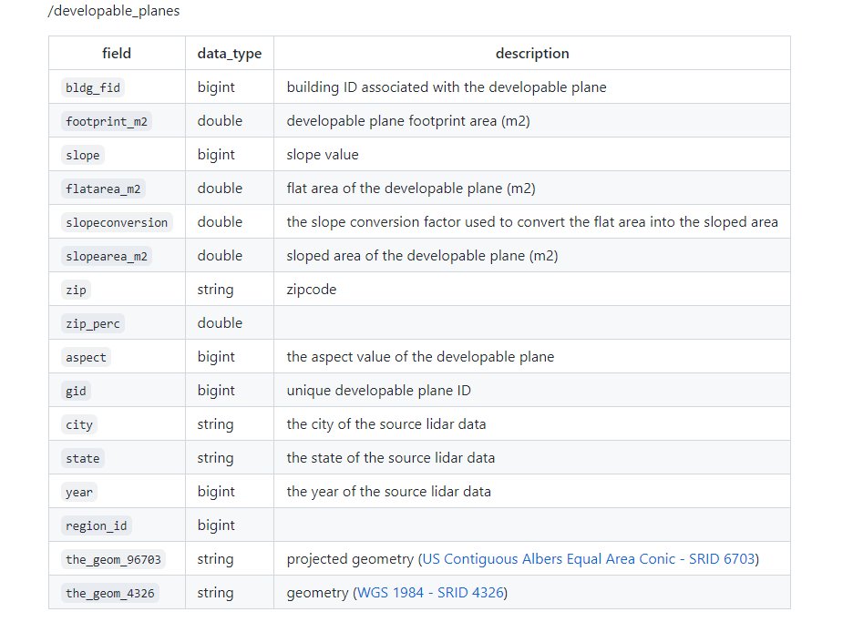
About the Data
Continued
Data is stored in parquet format in a S3 bucket sectioned into 4 specific datasets:
Aspects
Buildings
Developable Planes
RASD
In specific, we analyzed the aspect and developable planes sections
Table 1: Aspect in relation to buildings
Table 2: Developable Planes

Slide 5
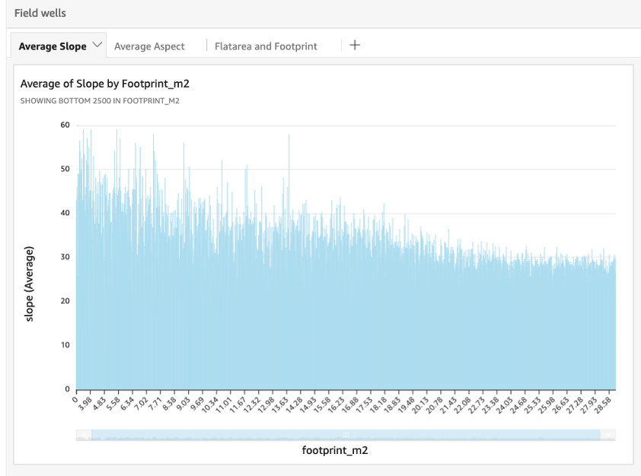


Analysis of Our Data
To better understand our data, we
Used AWS Glue to populate the catalog with our data as a table
Used QuickSight to create visualizations of our data
Table 3: Average slope by footprint square footage. to find a threshold of average slope in an area by the footprint square footage.

Slide 6
Prepping the Data

Slide 7
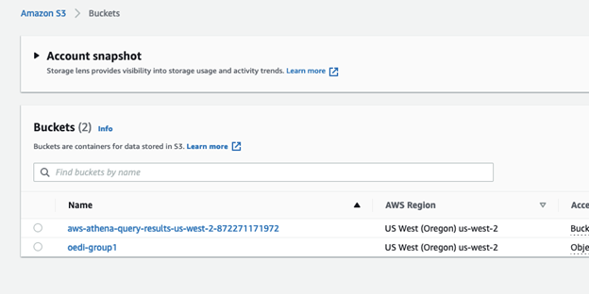
Figure 1: Location of S3 Bucket

Slide 8
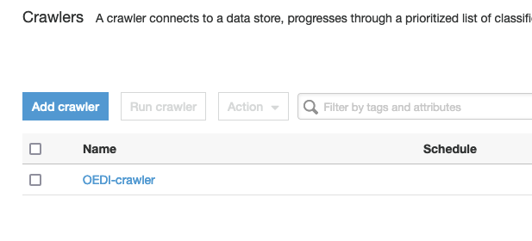
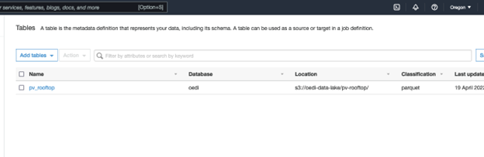
FIgure 2: Crawler created
FIgure 3: Table created by Crawler

Slide 9
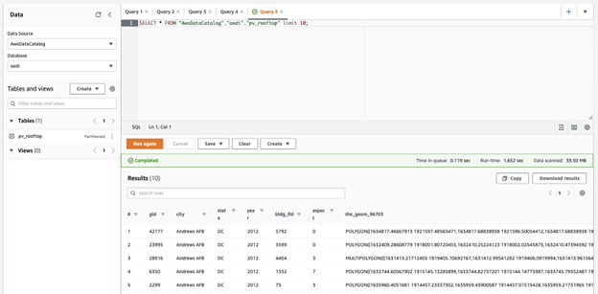
FIgure 4: Athena console where we can interact with data via SQL commands

Slide 10
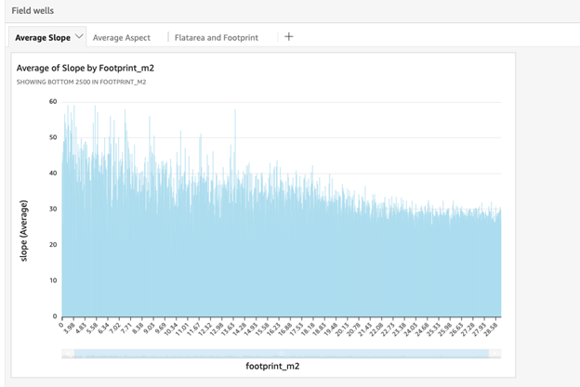
Figure 5: Average Slope by Footprint

Slide 11
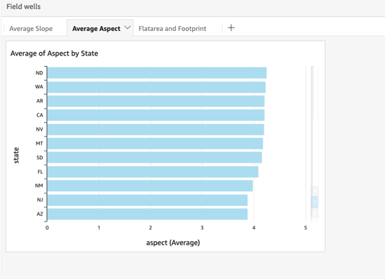
Figure 6: Average Aspect by State

Slide 12
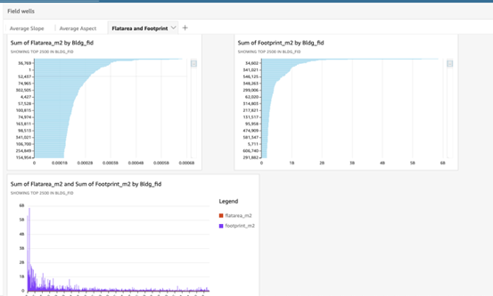
Figure 7: Sum of Footprint

Slide 13
Analyzing Data

Slide 14
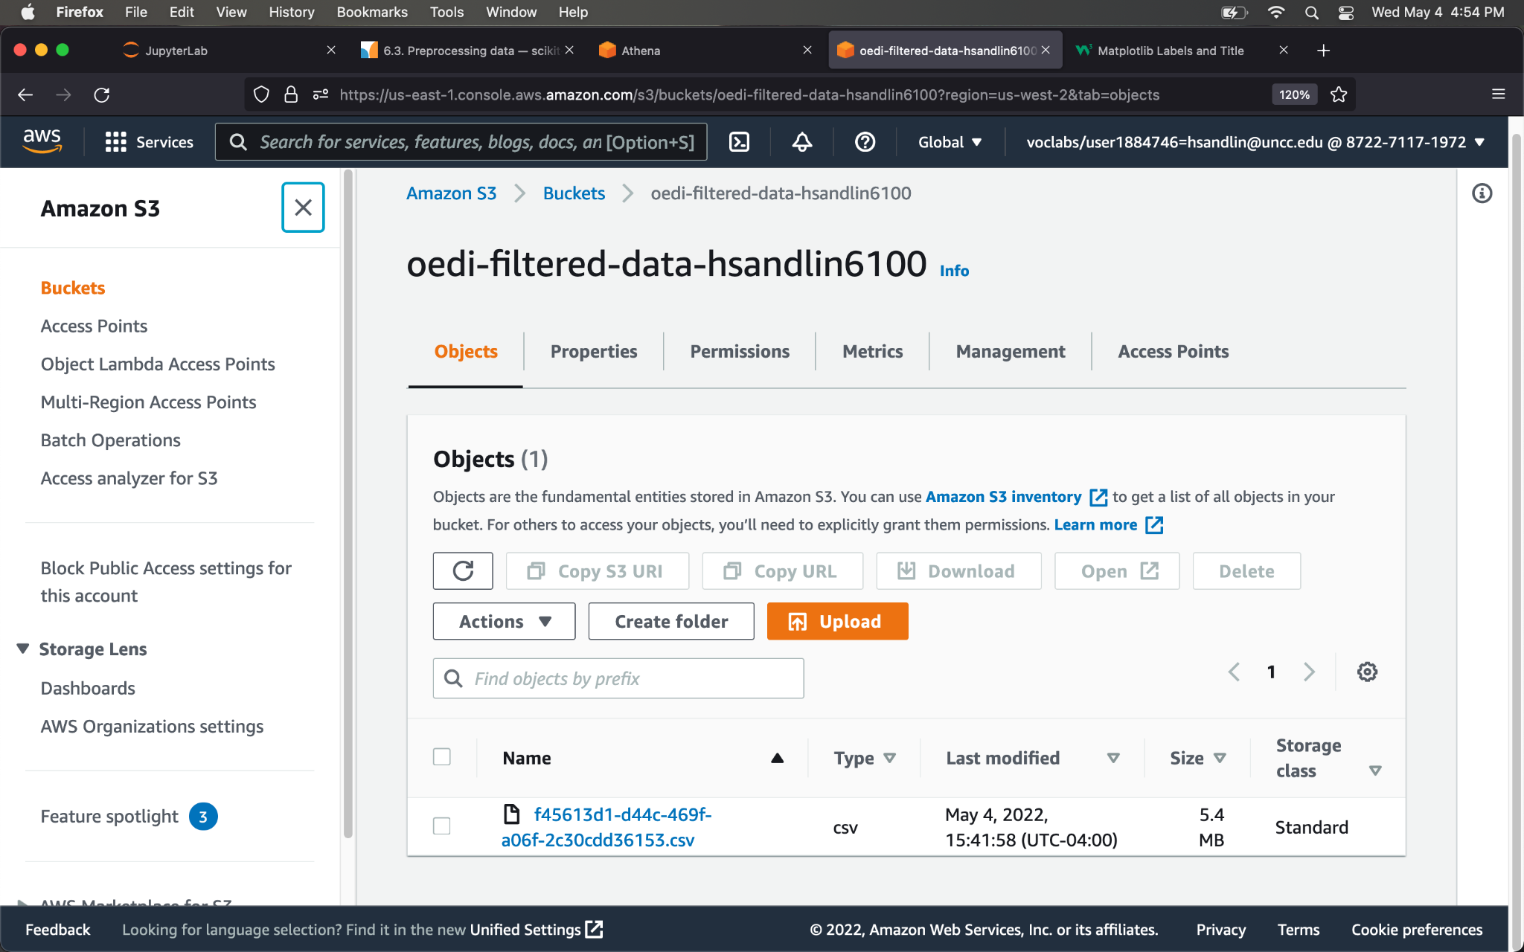
Figure 8: Data Stored in S3

Slide 15
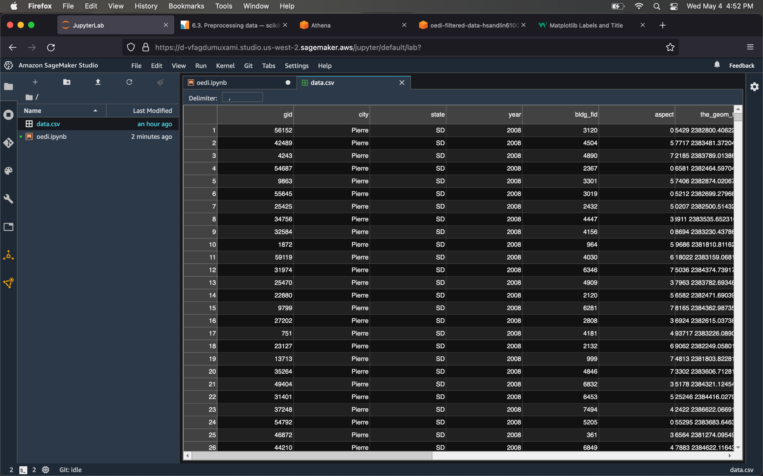
Figure 9: Data in SageMaker

Slide 16
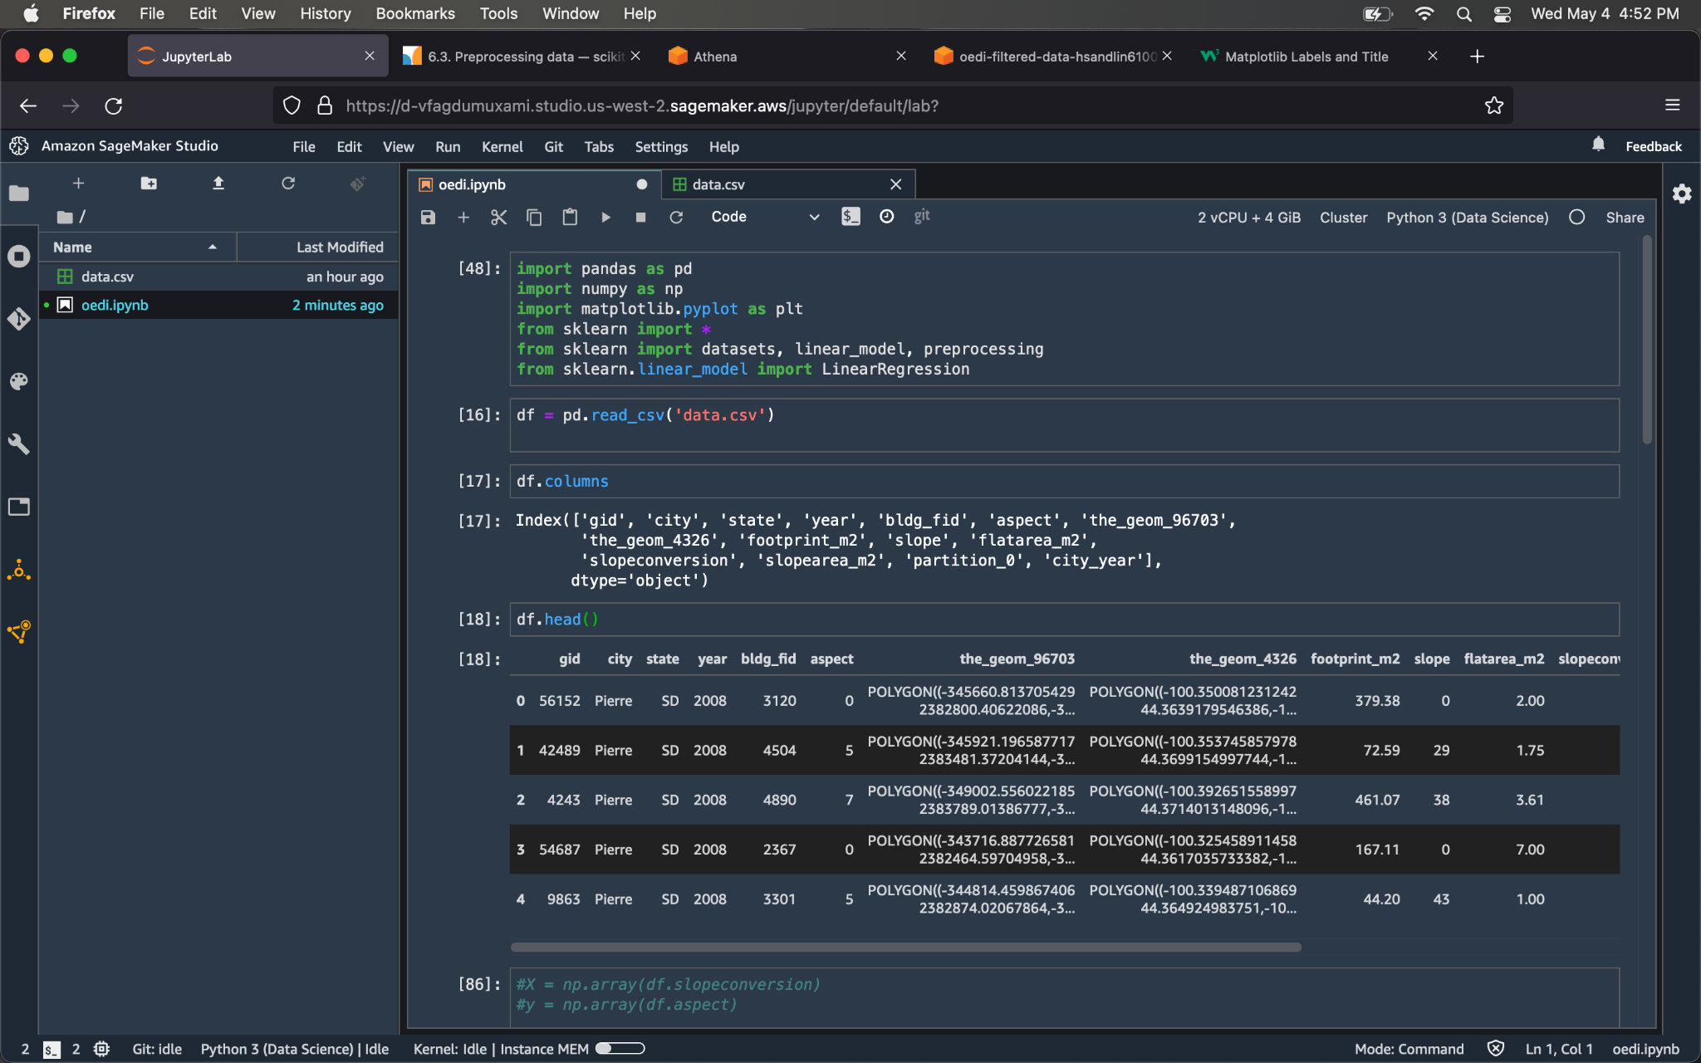
Figure 10: Code shown in SageMaker

Slide 17
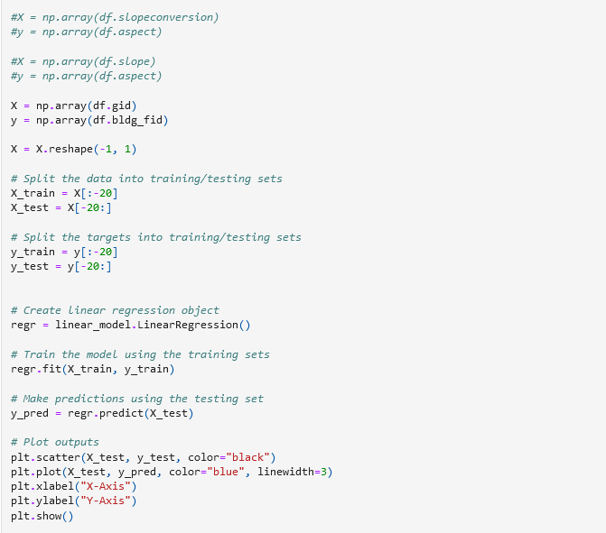
Figure 11: Our model (Linear Regression)

Slide 18
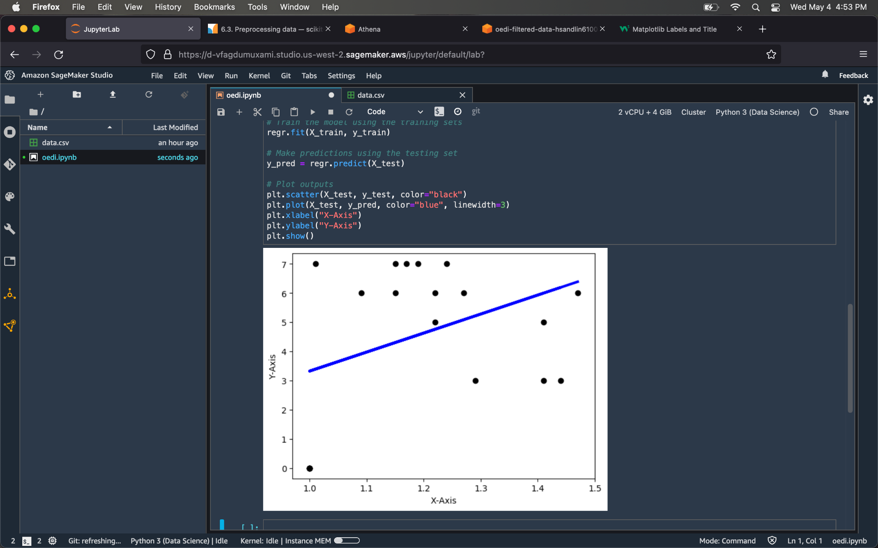
Figure 12: Plot 1

Slide 19
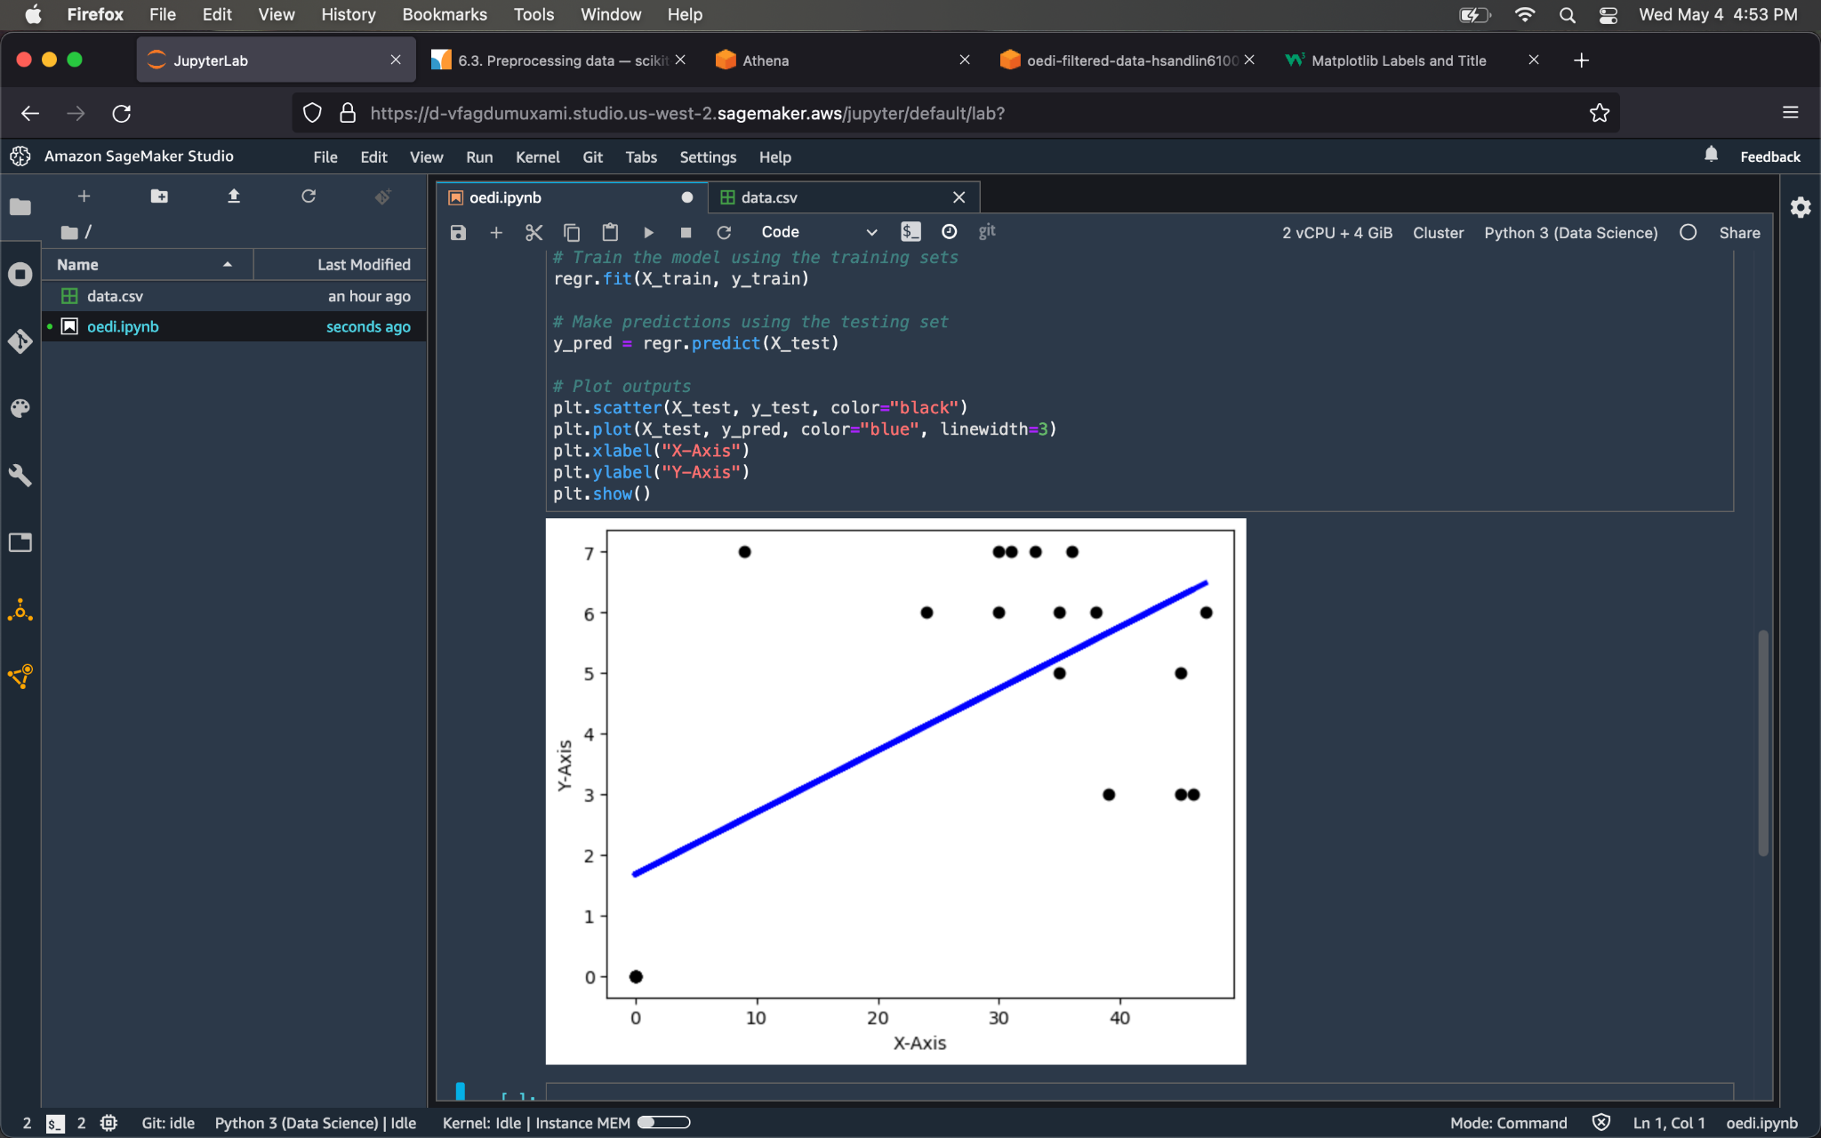
Figure 13:: Plot 2

Slide 20
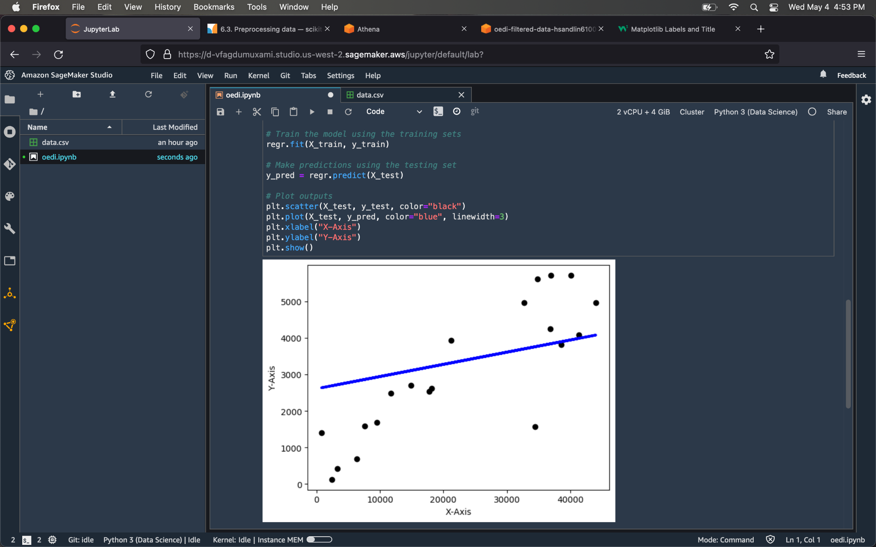
Figure 14: Plot 3

Slide 21
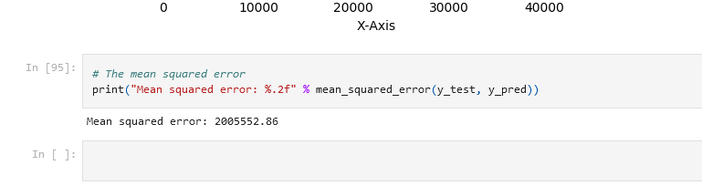
Figure 15: MSE

Slide 22
Planning for the Future
Improving our accuracy/performance was our biggest challenge.
In the future we can work on normalizing the dataset and having a better split of the data.
We can also perform batch gradient descent for better optimization.

